Slide 1
AWS Vs. Azure ML

Slide 2
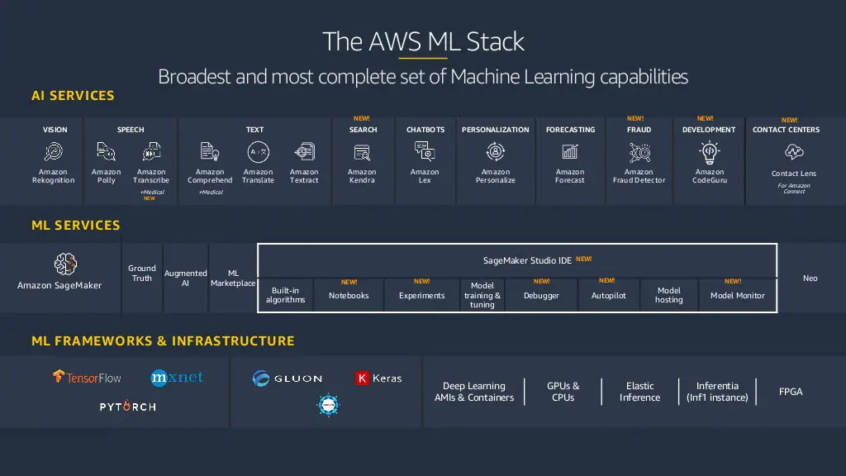
AWS ML

Slide 3
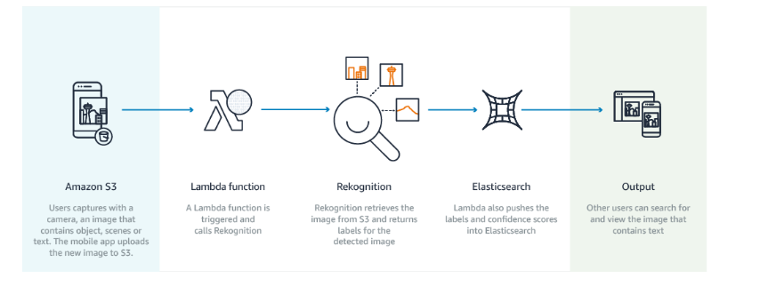
Animal Detection
1- Use AMazon deeplense device
https://aws.amazon.com/deeplens/
predefined deeplearning projects or you can create your own
2- Amazon Rekognition

Slide 4
Game Bot
Interact with the Frozen Lake environment from the OpenAI Gym.
Build and train a model locally and then as a training job in SageMaker.
Find the best model by running a hyperparameter tuning job.
https://automatic-game-leveling.workshop.aws/en/10-introduction.html

Slide 5
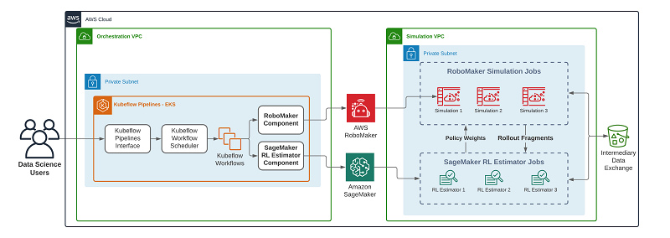

Slide 6
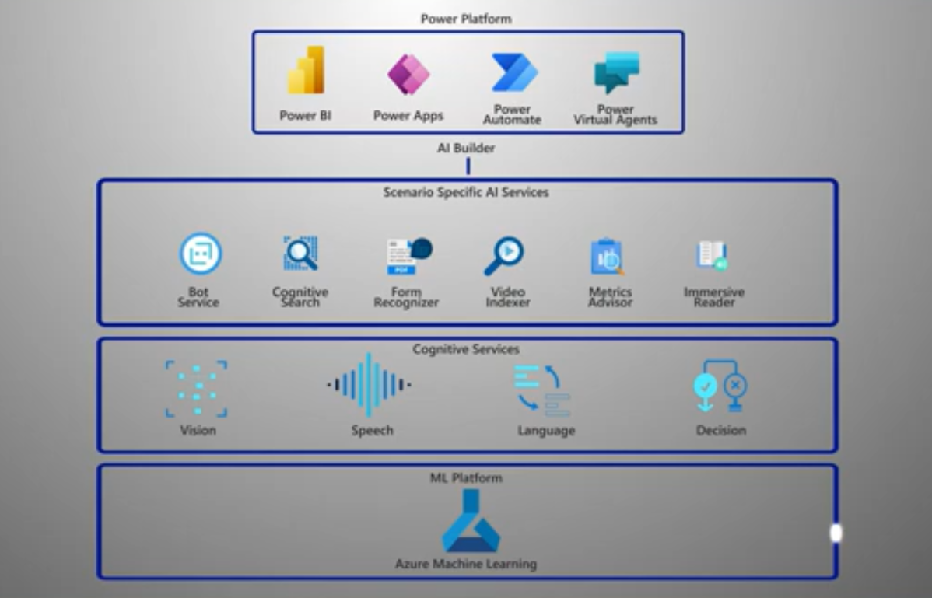
Azure ML

Slide 7
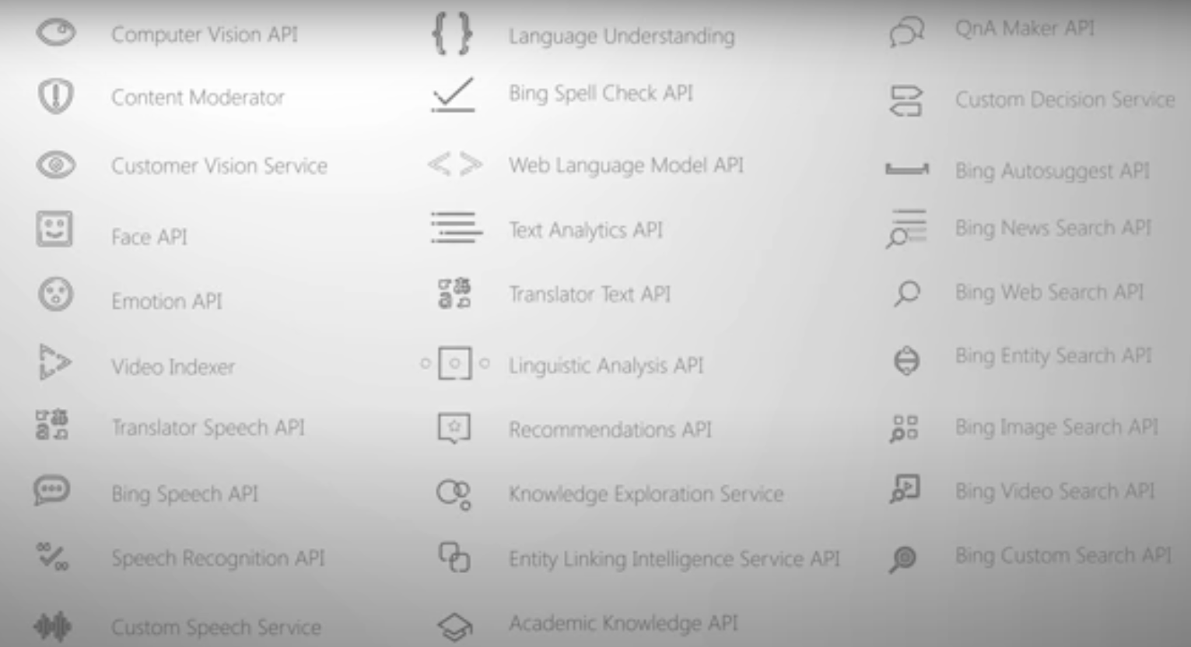
Azure Services

Slide 8
Anomaly Detector
Easily add anomaly detection capabilities to your apps.
Azure Bot Services
Intelligent, serverless bot services that scale on demand
Azure Cognitive Search
AI-powered cloud search service for mobile and web app development
Azure Databricks
Fast, easy, and collaborative Apache Spark-based analytics platform
Azure Machine Learning
Bring AI to everyone with an end-to-end, scalable, trusted platform with experimentation and model management
Azure Open Datasets
Cloud platform to host and share curated open datasets to accelerate development of machine learning models
Azure Cognitive Services
Deploy high-quality AI models as APIs
Azure Video Analyzer PREVIEW

Slide 9
An AI service for quickly building video analytics solutions
Computer Vision
Distill actionable information from images
Content Moderator
Automated image, text, and video moderation
Custom Vision
Easily customize your own state-of-the-art computer vision models for your unique use case
Data Science Virtual Machines
Rich pre-configured environment for AI development
Face API
Detect, identify, analyze, organize, and tag faces in photos
Azure Form Recognizer
The AI-powered document extraction service that understands your forms

Slide 10
Kinect DK
Build computer vision and speech models using a developer kit with advanced AI sensors
Language Understanding
Teach your apps to understand commands from your users
Microsoft Genomics
Power genome sequencing & research insights
Personalizer
An AI service that delivers a personalized user experience
Project Bonsai PREVIEW
A machine teaching service for creating intelligent industrial control systems using simulations
QnA Maker
Distill information into conversational, easy-to-navigate answers

Slide 11
Speaker Recognition PREVIEW
A Speech service feature that verifies and identifies speakers
Speech to Text
A Speech service feature that accurately converts spoken audio to text
Speech Translation
Easily integrate real-time speech translation to your app
Text Analytics
Easily evaluate sentiment and topics to understand what users want
Text to Speech
A Speech service feature that converts text to lifelike speech
Translator
Easily conduct machine translation with a simple REST API call
Azure Metrics Advisor
An AI service that monitors metrics and diagnoses issues
Health Bot
A managed service purpose-built for development of virtual healthcare assistants
Azure Percept PREVIEW
Accelerate edge intelligence from silicon to service
Azure Applied AI Services
Specialized services that enable organizations to accelerate time to value in applying AI to solve common scenarios

